Slide 1
Meeting Outline
Asked for extension of 4 weeks
  Got accepted new deadline 25 Oktober
Closed-loop training
  Implementation
  Results
  Problem: Open-loop performance degrades with closed-loop
GPU implementation
  Earlier attempt no speedup
Longer training runs
  More complex neural network and more additional states → no real benefit

Slide 2
Closed-loop training biased open-loop makes it worse
  Fine for ASMPT if we do in closed-loop
GPU, why didn’t it work earlier
  Opens up the possibility to do even up to 3 seconds
Now in open-loop even ran up to 3 seconds
  Result:
Orthogonality
Laten zien wat de nieuwe error is met 50-50 split ten opzichte van eerst
Nu leren de additional states wel, maar laten zien zoals Jan dit laat zien.
FRF

Slide 3
Open-loop
Is de issue dat de data wordt gegenereerd in closed-loop
Kijken data genereren in open-loop
Kijken of er een offset komt. Kan ik dan alleen multisine doen, reference/motion profile gaat niet echt.
Als er een offset komt, dan kan ik de inverse van de plant er in verwerken…

Slide 4
Closed-Loop
Controller
Training in open-loop could not improve
  Increasing the window length did not help
Controller implementation:

Slide 5
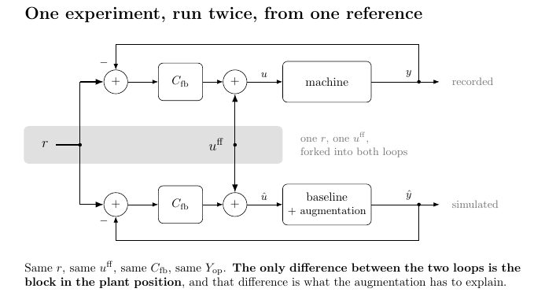
Notes:
Each simulation window we start with zero controller correction.
ŷ[k] = h(x[k]) <- model output at k, from the STATE only
e[k] = y[k] - ŷ[k]
u_fb[k]= Cc xc[k] + Dc e[k]
û[k] = u[k] + u_fb[k]x[k+1] = f(x[k], û[k]) <- û[k] produces ŷ[k+1], not ŷ[k]
xc[k+1]= Ac xc[k] + Bc e[k]
ŷ[k] is used to build û[k]; û[k] then moves the state forward and so determines ŷ[k+1]. It is not the same ŷ on both sides of the equal sign, it is k and k+1.
- Controller initial condition. xc = 0 at every window start.

Slide 6
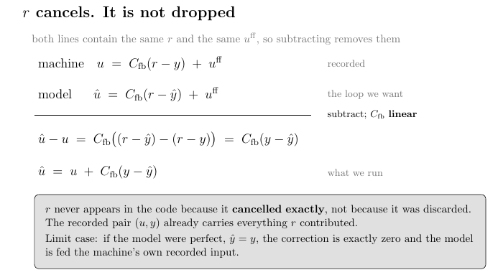
Notes:
Each simulation window we start with zero controller correction.
ŷ[k] = h(x[k]) <- model output at k, from the STATE only
e[k] = y[k] - ŷ[k]
u_fb[k]= Cc xc[k] + Dc e[k]
û[k] = u[k] + u_fb[k]x[k+1] = f(x[k], û[k]) <- û[k] produces ŷ[k+1], not ŷ[k]
xc[k+1]= Ac xc[k] + Bc e[k]
ŷ[k] is used to build û[k]; û[k] then moves the state forward and so determines ŷ[k+1]. It is not the same ŷ on both sides of the equal sign, it is k and k+1.
- Controller initial condition. xc = 0 at every window start.

Slide 7
Training in Closed-Loop
Compared to open-loop closed-loop training did learn
Main issue for the following slides:
  Additional sates where not learning
Increased mass split to 50-50 after

Slide 8
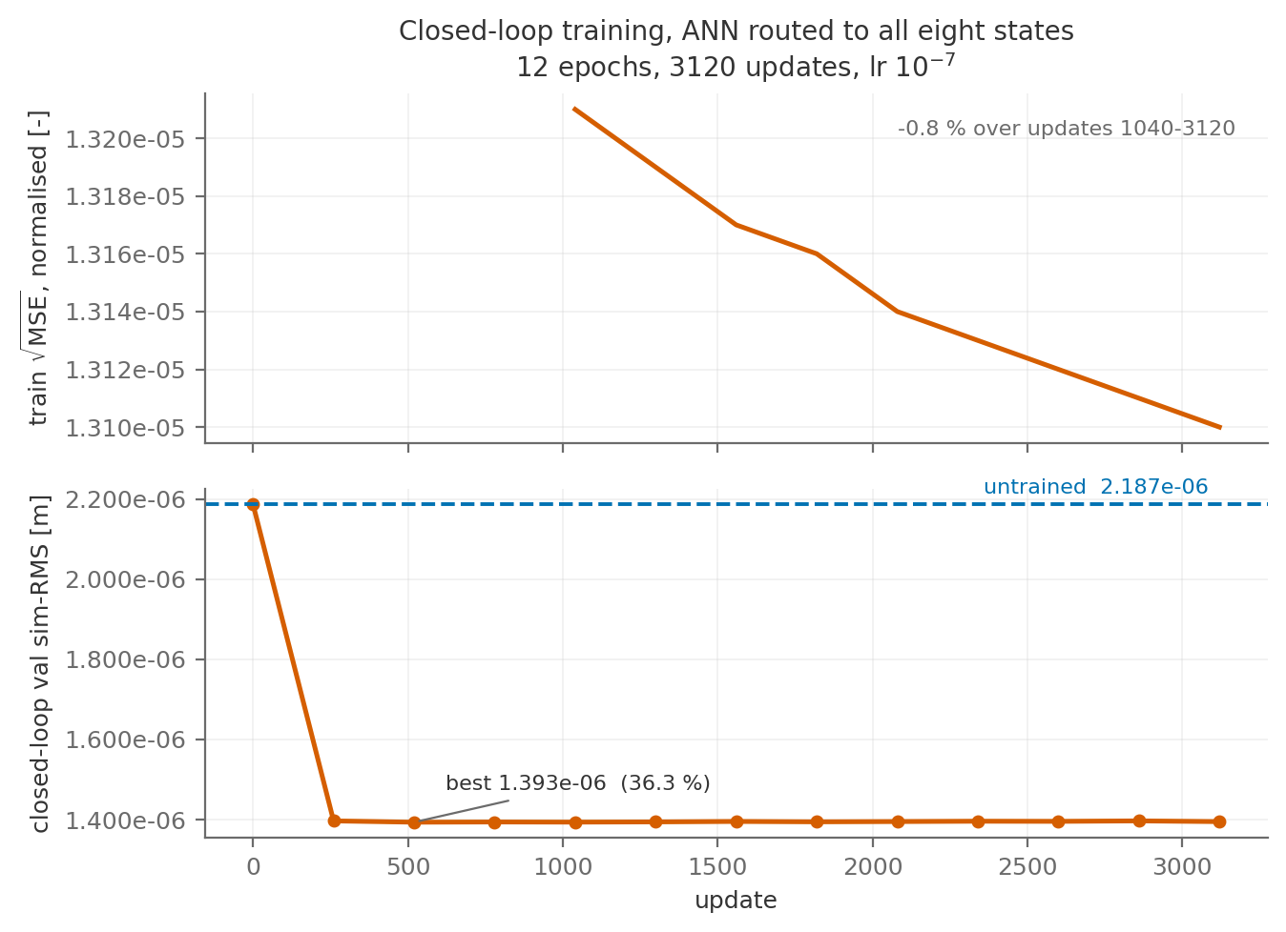

Slide 9
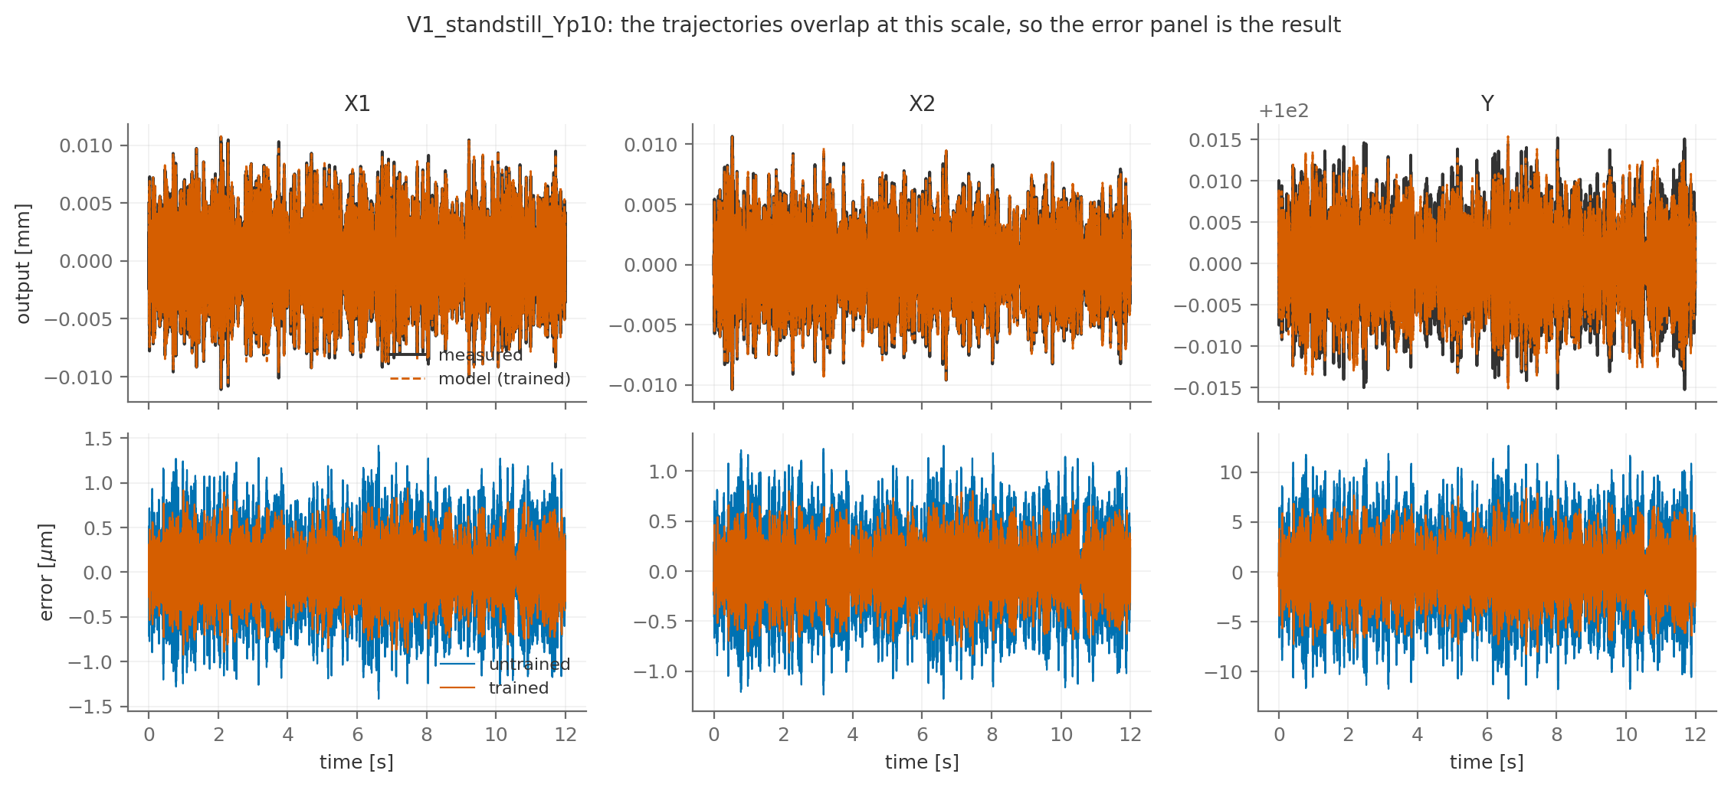

Slide 10
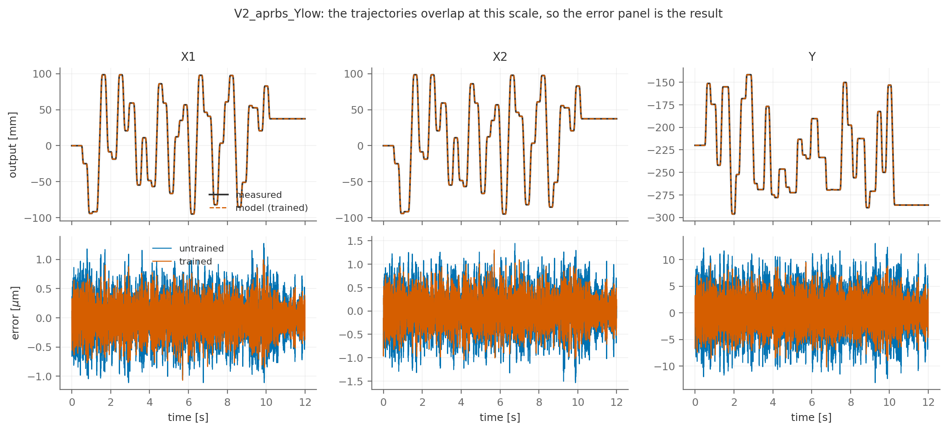

Slide 11
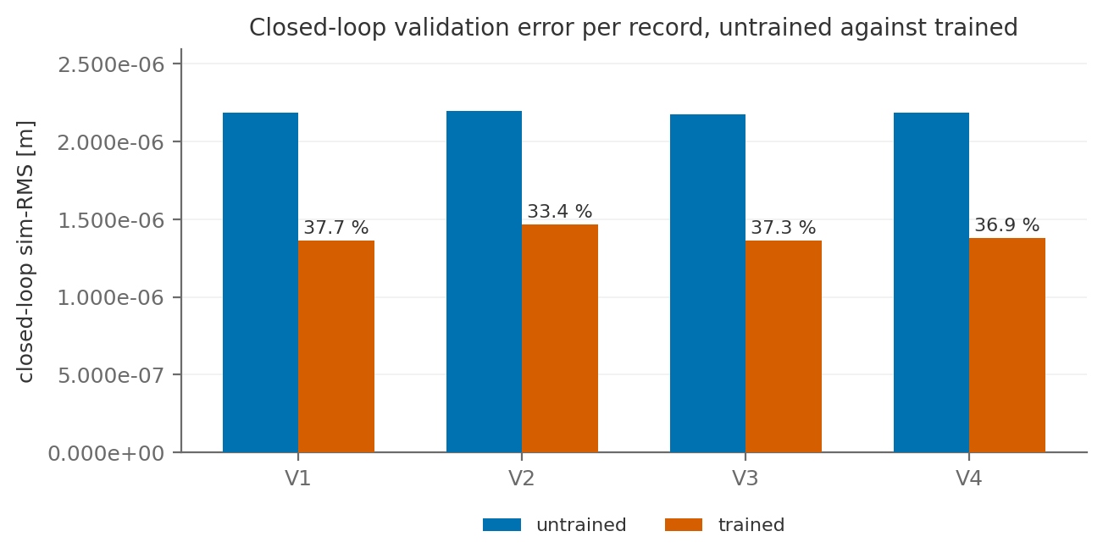

Slide 12

Model = System

Slide 13
Increasing training window from 0.1 s to 0.2 s or 0.3 s found the same optimum within the same optimization window
Model = System

Slide 14
Augmented states not learning
Next slides:
  Only the ANN correction to the physical states caused the 36% improvement.
  The augmented states didn’t improve: no incentive to learn

Slide 15
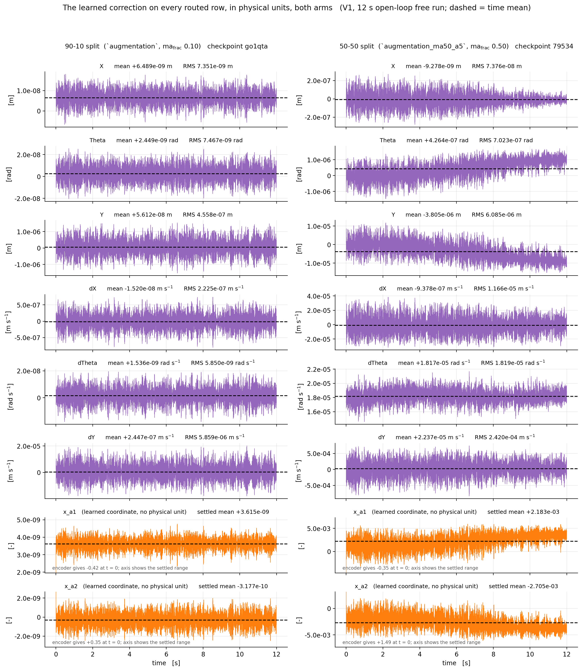

Slide 16
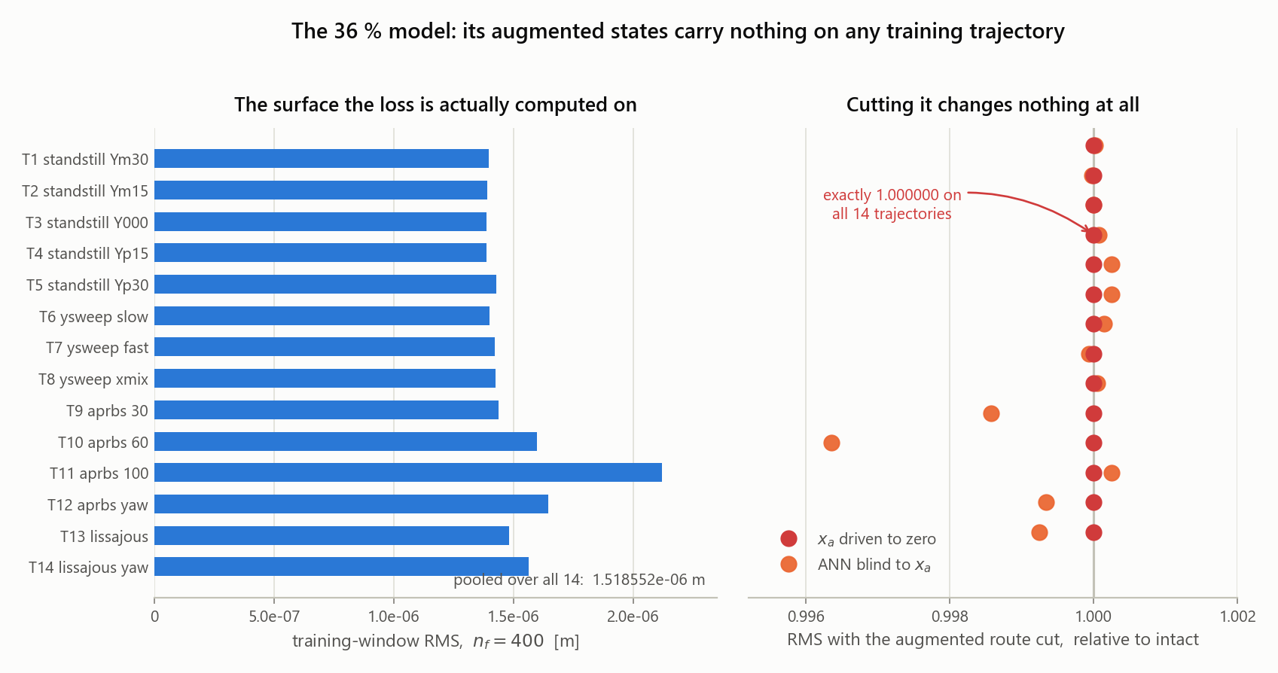

Slide 17
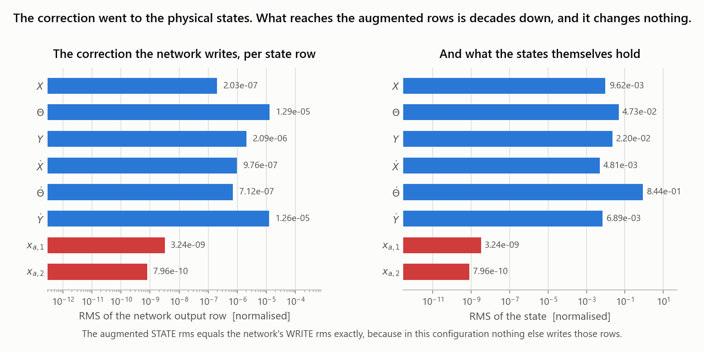

Slide 18
System Error not big enough?
MSD payload mass previously: 10% and 90% respectively
For the following images 50%-50% split, and the excitation amplitude scaled 5x, taking the input force from 4.4e+01 N to 2.2e+02 N RMS on X1/X2 and 3.6e+01 N to 1.4e+02 N on Y.
Notes:
Force ratio is not 5x across the dataset. It ranges 0.98x to 5.07x.- Standstills and Y-sweeps: ~5.0x on X, ~3.75x on Y (T1-T7, V1, V3, E2)- APRBS and lissajous: 1.2x to 2.9x- E4_multisine_off: 1.00x, unchangedBecause AMP_SCALE scales the excitation, not the total input. On a standstill the force is almost pure excitation so it scales ~5x; on an APRBS record the trajectory-following force dominates and barely moves.
Net effect on the absorber displacement, which is what the augmentation has to learn: 2.19e-05 m to 3.17e-05 m, a factor 1.45, because the mass-fraction change worked against the amplitude change.

Slide 19
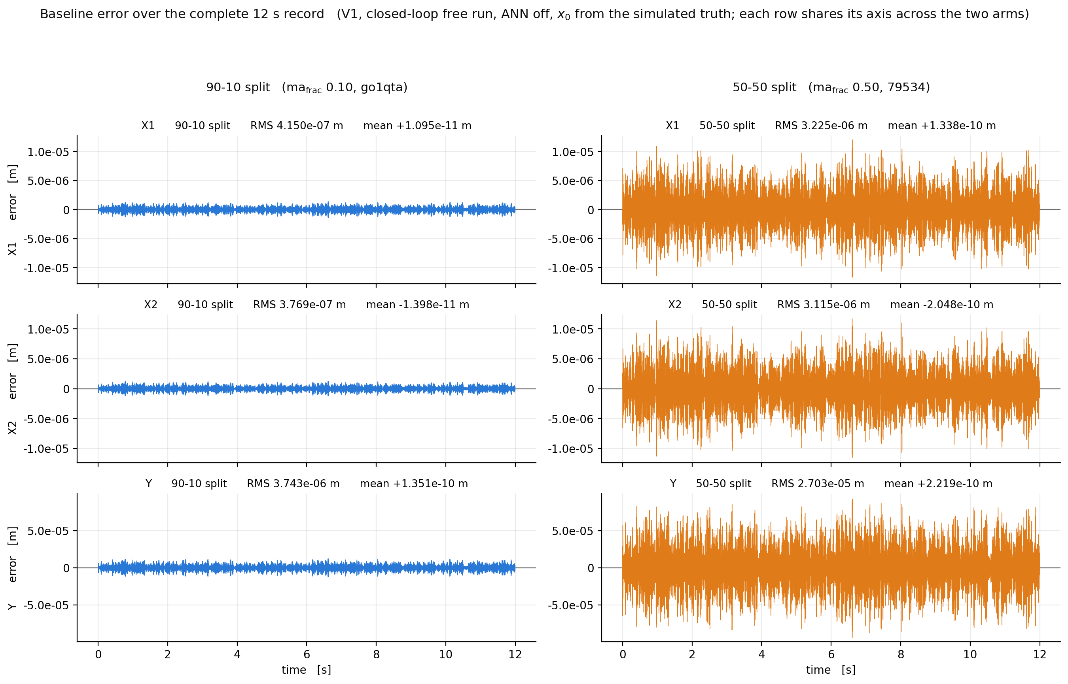

Slide 20
Multisine mismatch
The following results were trained with data that was generated with multisine band with 130-180hz
With the 50-50 split the resonance moved

Slide 21
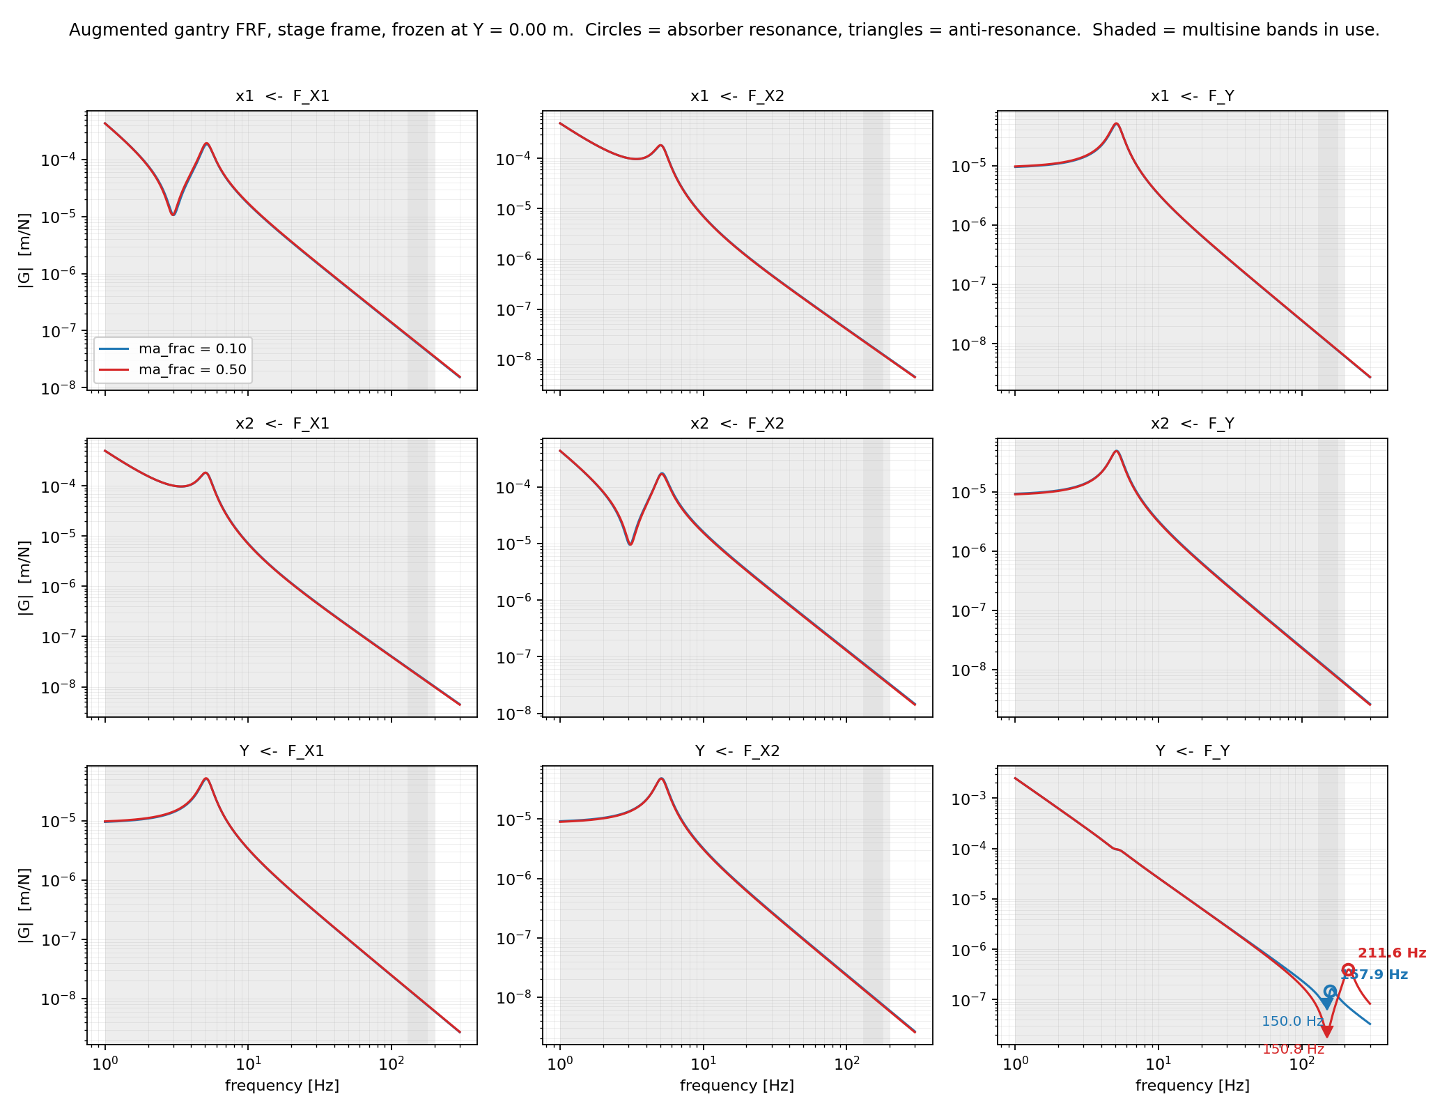

Slide 23
Clear improvement for learning additional states

Slide 24
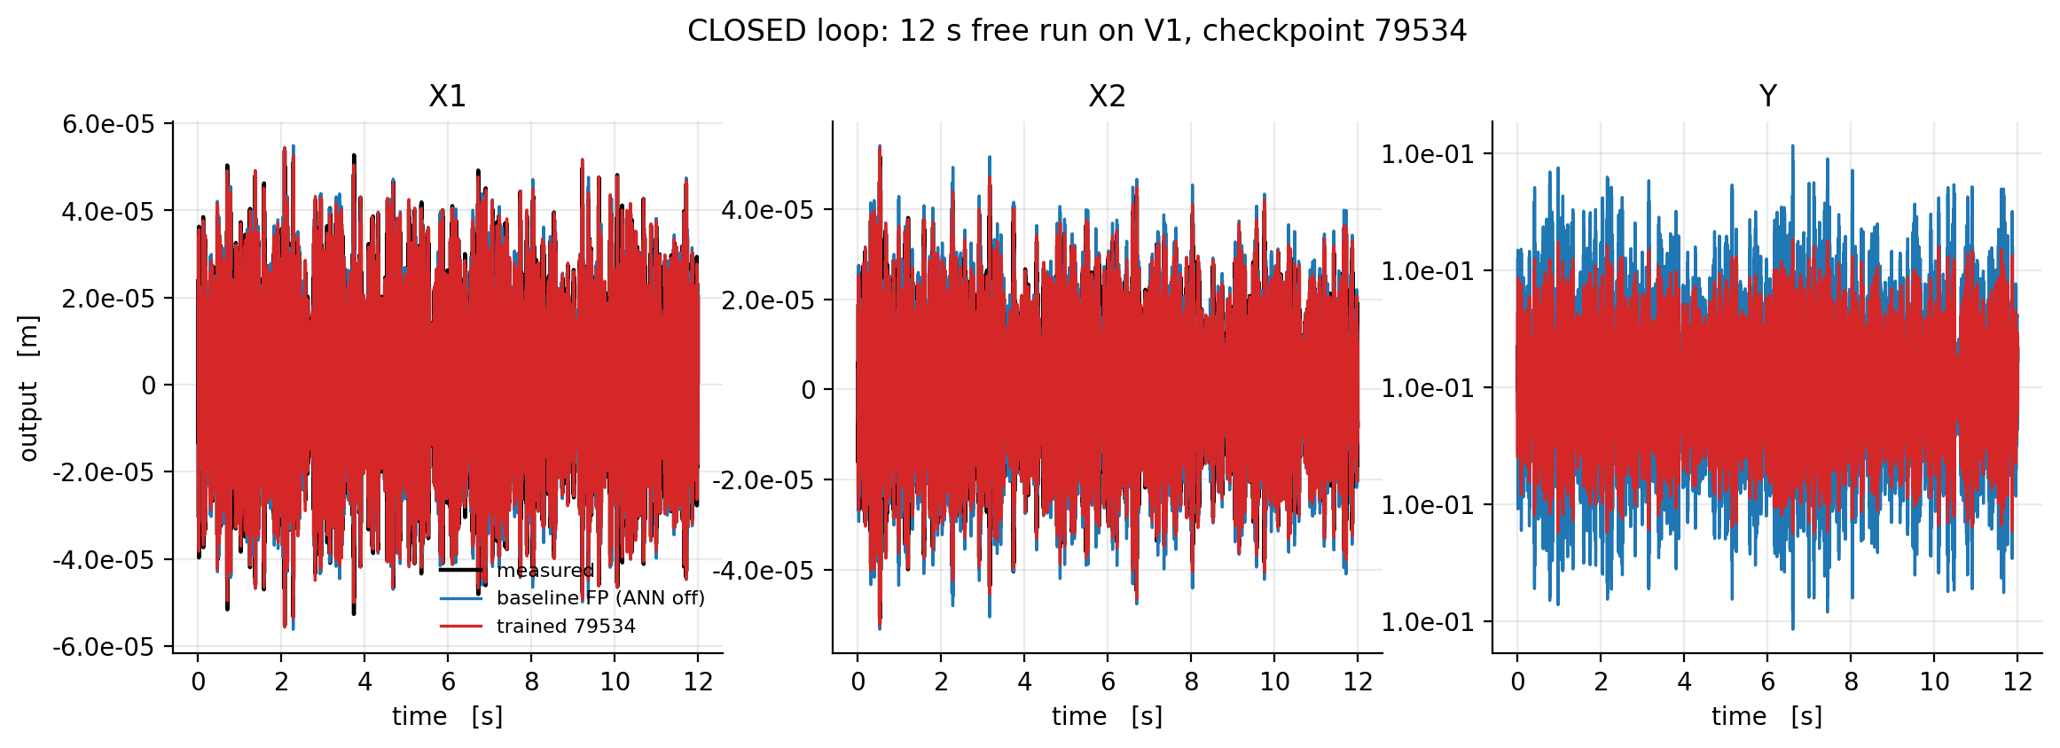
Training in closed-loop degrades open-loop performance

Slide 25
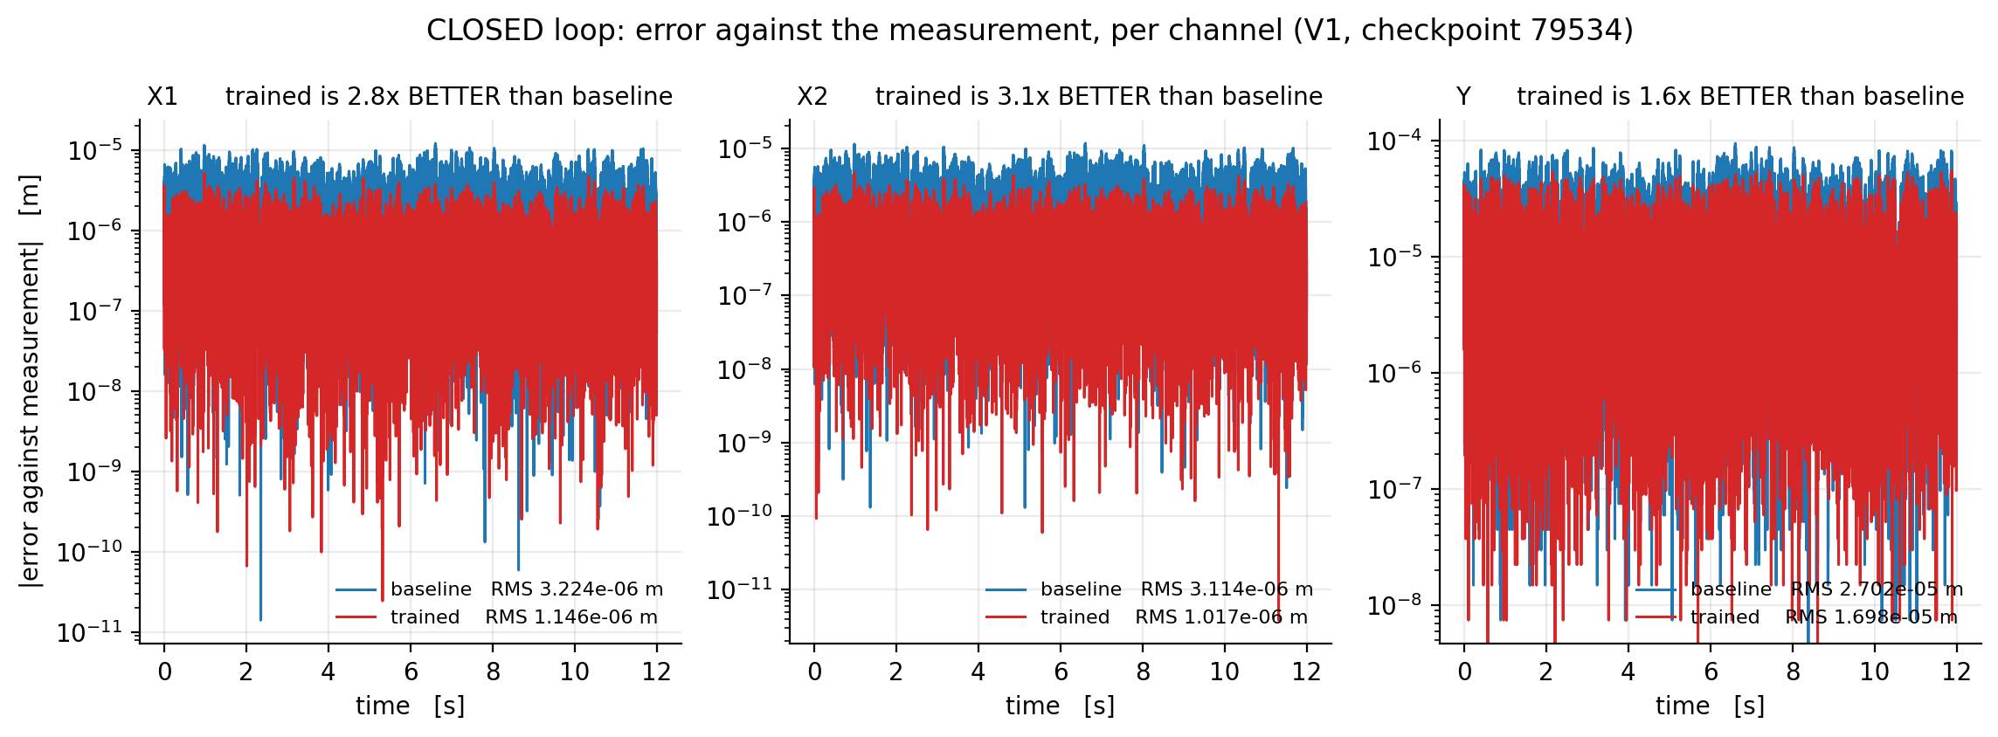

Slide 26
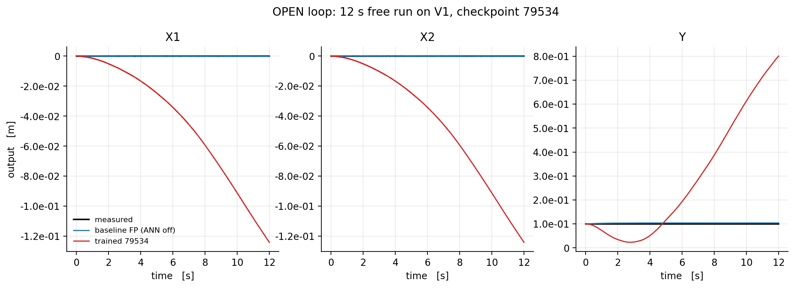
Trained in Closed-Loop

Slide 27
Trained in Closed-Loop
Training in closed-loop get an estimation of the plant and the controller → Not pure plant identification

Slide 28
Question
Is improving training in open-loop also an acceptable objective?
ASMPT is okay with this

Slide 29
V1 replay signal closed-loop in open-loop

Slide 30
GPU training
Why the GPU did not help before
  The model does thousands of tiny operations, almost no real computation
  Cost is dominated by sending work to the GPU, not by doing it
  A stronger GPU changes nothing: two cards with 4.5x different power gave the same speed
What changed
  Compiling the model merges those tiny operations and replays them as one block
  This was blocked by a single line in the framework; fixing it left the model unchanged
  Once cost is per operation, a larger batch is nearly free
Result
  ~10x faster per update, ~20x more data per second
  18 epochs → ~350 epochs in the same wall time
Takeaway
  The GPU was not computing too slowly, it was being fed too slowly
Notes:
In model_augmentation/fit_systems/interconnect.py, inside init_forward, at line 212:# beforeself.order_output_signal_computation.append(element)# afterself.order_output_signal_computation.append(int(element))

Slide 31
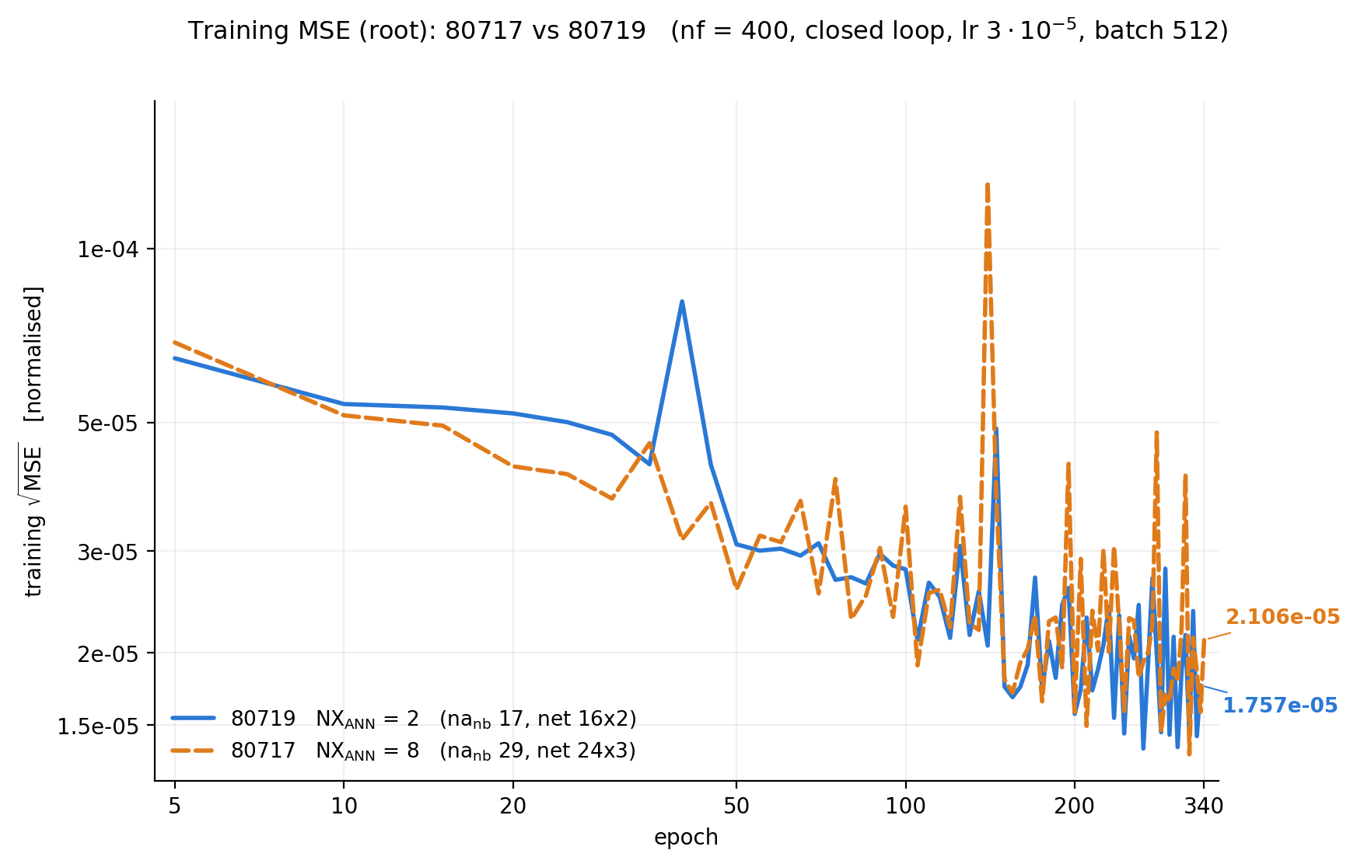
Training is not converged yet

Slide 32
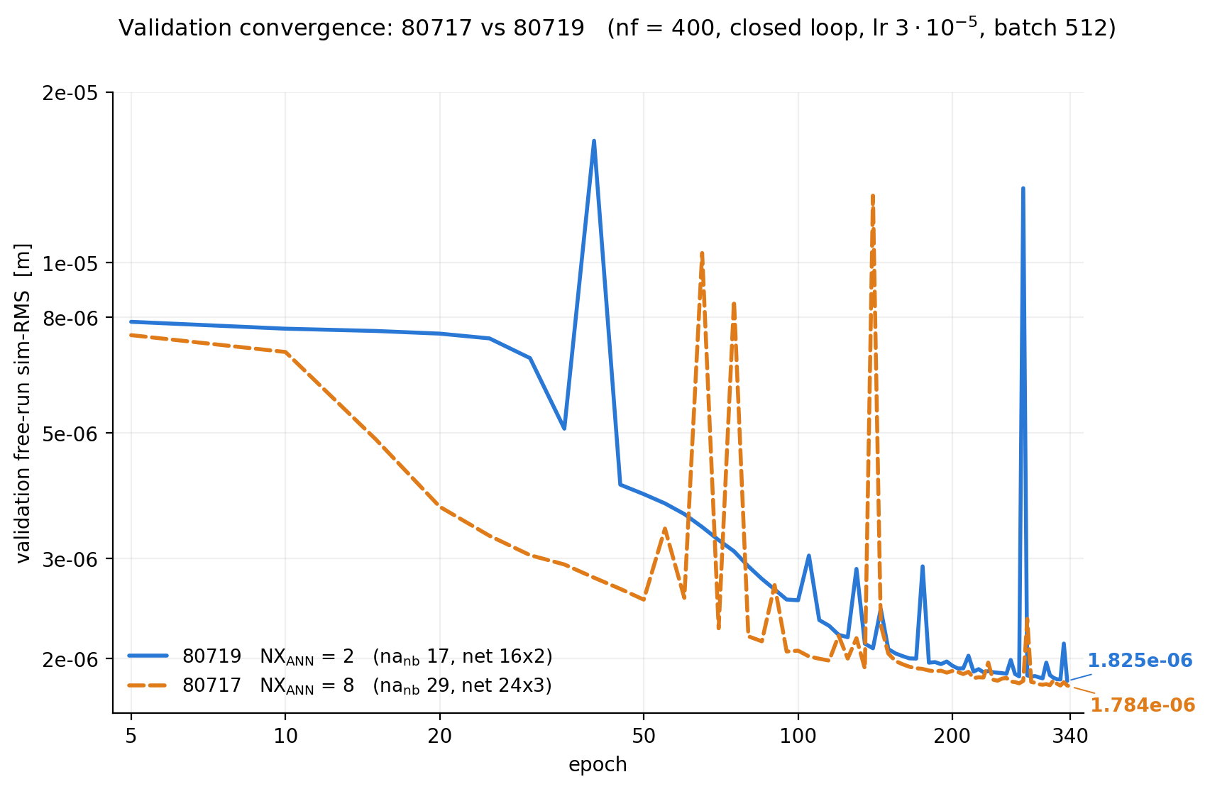
Notes:
│ 80719 (NX2) │ 1.5800e-5 │ 1.8255e-6 │ 88.45 % │ 8.66x │
│ 80717 (NX8) │ 1.5799e-5 │ 1.7838e-6 │ 88.71 % │ 8.86x │
So the honest sentence is "the augmentation removes 88% of the baseline's remaining mismatch", not "the model is 88% better".

Slide 33
Figures
  Loss and Validation
    Both not converged
  Learned error for validation X1 X2 Y
  Best two augmented states (all states but also show the difference between nx = 2 or nx = 6)

Slide 34
Can now train up to 3 seconds
Didn’t improve much over 400 nf
Open-loop training started did…
Then what is the issue that we cant learn in open loop?

Slide 35
Show combinations different states
Also show for these end result in closed-loop
And the states magnitudes as in Jan

Slide 36
Open-loop not learning
Currently training open-loop with window = 3 seconds
  Does not improve over first 5 epochs
Data generated by system in closed-loop
  Could I resolve the issue by generating data in open-loop, because the next y is correlated with the previous controller input.
  And then for the real system filter out the known controller of the input
  Or because I don’t have noise currently is there no bias?

Slide 37
Question
Open-loop training can train on the 0.1s window length but this does not extrapolate to the 12s validation.
Could it help for open-loop training if I remove the controller from the data?
  First generate data in open-loop.
  And if that converges in training move to removing the controller from the data generated with the controller
    → Similar as how it would be done with the real gantry data

Slide 38
GPU training
Why the GPU did not help before
  The model does thousands of tiny operations, almost no real computation
  Cost is dominated by sending work to the GPU, not by doing it
  A stronger GPU changes nothing: two cards with 4.5x different power gave the same speed
What changed
  Compiling the model merges those tiny operations and replays them as one block
  This was blocked by a single line in the framework; fixing it left the model unchanged
  Once cost is per operation, a larger batch is nearly free
Result
  ~10x faster per update, ~20x more data per second
  18 epochs → ~350 epochs in the same wall time
Takeaway
  The GPU was not computing too slowly, it was being fed too slowly
Notes:
In model_augmentation/fit_systems/interconnect.py, inside init_forward, at line 212:# beforeself.order_output_signal_computation.append(element)# afterself.order_output_signal_computation.append(int(element))

Slide 39
Time window can’t reach

Slide 40
Main Problem
Current training windows are too short and computational inconceivable to go into the seconds.
Methods that allow to connect multiple windows interfere with SUBNET
  SUBNET is used to initialize the states of each window, part of the training of the current framework is the training of SUBNET
  Methods such as multiple shooting require on the window boundaries for the states to be continuous
    Could train SUBNET with less initializations
    Need to look at controller currently reset per window to 0 correction
Notes:
Main problem: the loss cannot see a DC error
- The gantry has two free integrators (X and Y rigid body, poles at |z| = 1). A constant error in the augmentation produces position error growing as t^2, so over a 0.1 s window it is still ballistic and the loss sensitivity to it is near zero. Measured: dL/d(eps) is -6.2e-02 at nf = 400 (wrong sign) against +1.5e+04 at nf = 12000.
Sensitivity grows only as T^2, so recovering it by window length alone needs windows of seconds, which is computationally out of reach.
Kessels does not have this problem: his academic plant is grounded by a spring (wn T ~ 1.3), and his wire bonder is grounded by the servo loop. His truncated
window loss is a valid surrogate for the full-record error; ours is not.
Why the obvious fixes fight the framework
Multiple shooting requires state continuity at window boundaries, but SUBNET is the boundary condition: the encoder supplies the initial state per window and is trained jointly
Options: fewer encoder initialisations (longer windows, same cost), or continuity as a penalty rather than a constraint.
Likely cheapest lever
- The controller correction is reset to zero at every window start, which destroys the loop's integral action at each boundary and removes precisely the grounding that would make a DC error visible within T. Carrying controller state across windows may recover observability without touching the window length.

Slide 41
Down Sampling

Slide 42
To do
Move on to orthogonality implementation
Test if generating data in open-loop and training in open-loop converges?

Slide 43

Baseline model

Slide 44

System for data generation

Slide 45

Augmentation
Overview
Notes:
Kijken gaug is dat augmented states?

Slide 46
Planning
Have been sitting on the same problem for ~3 months
Cannot find a solution in the literature that includes SUBNET
Need to move on to orthogonality, but the rest of the work is dependent on proper augmentation
Will for now need to accept improved performance with plant degradation

Slide 48
Downsampling

Slide 49
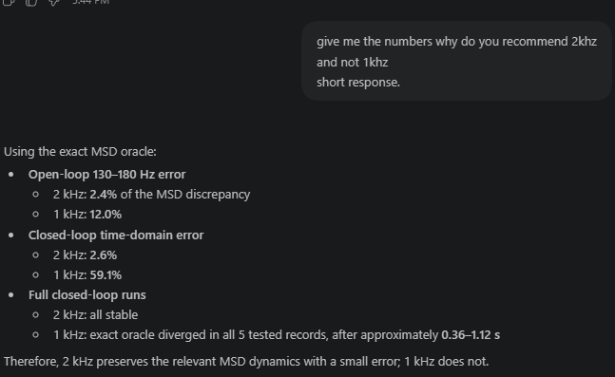
Downsampling

Slide 50
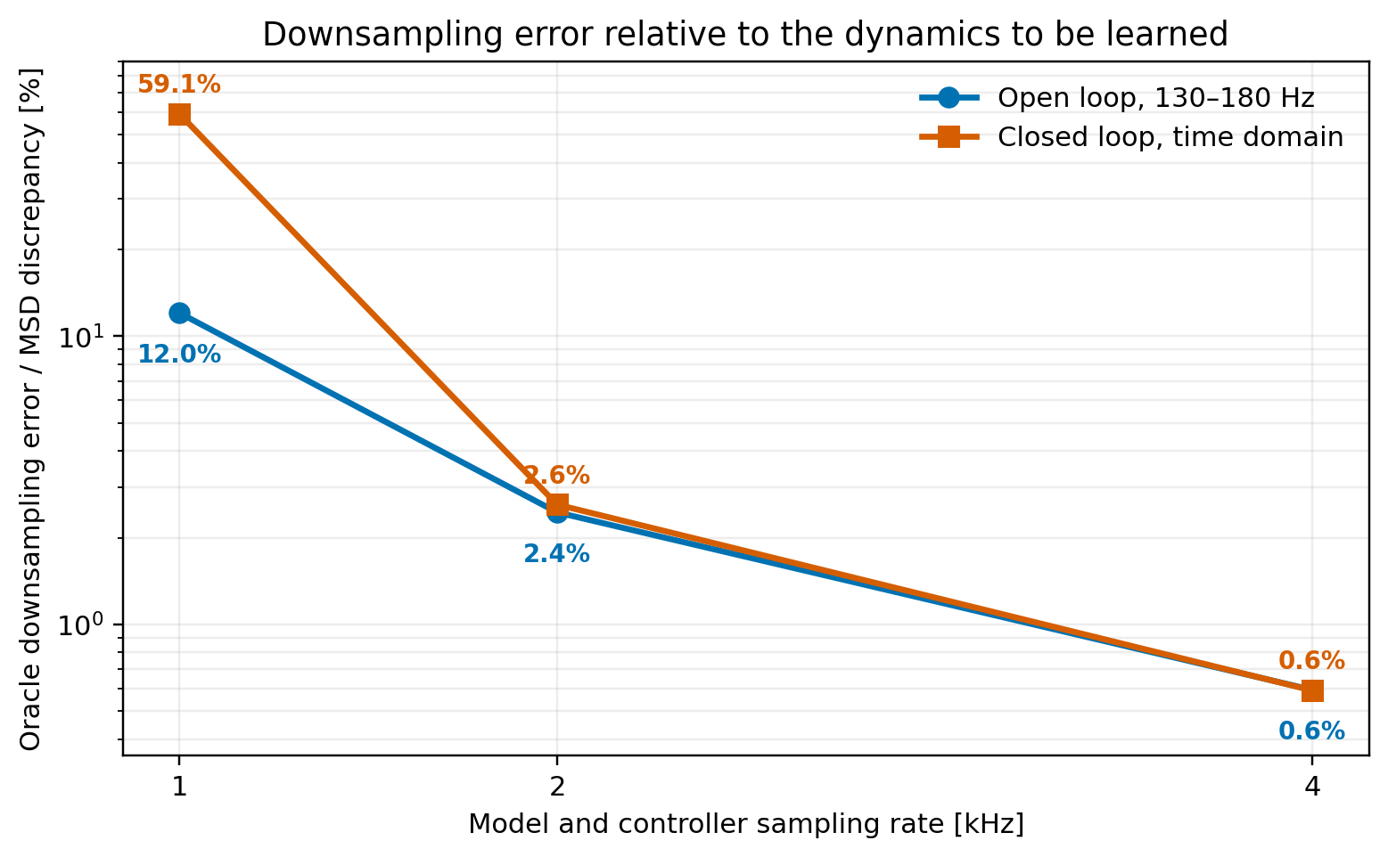

Slide 51
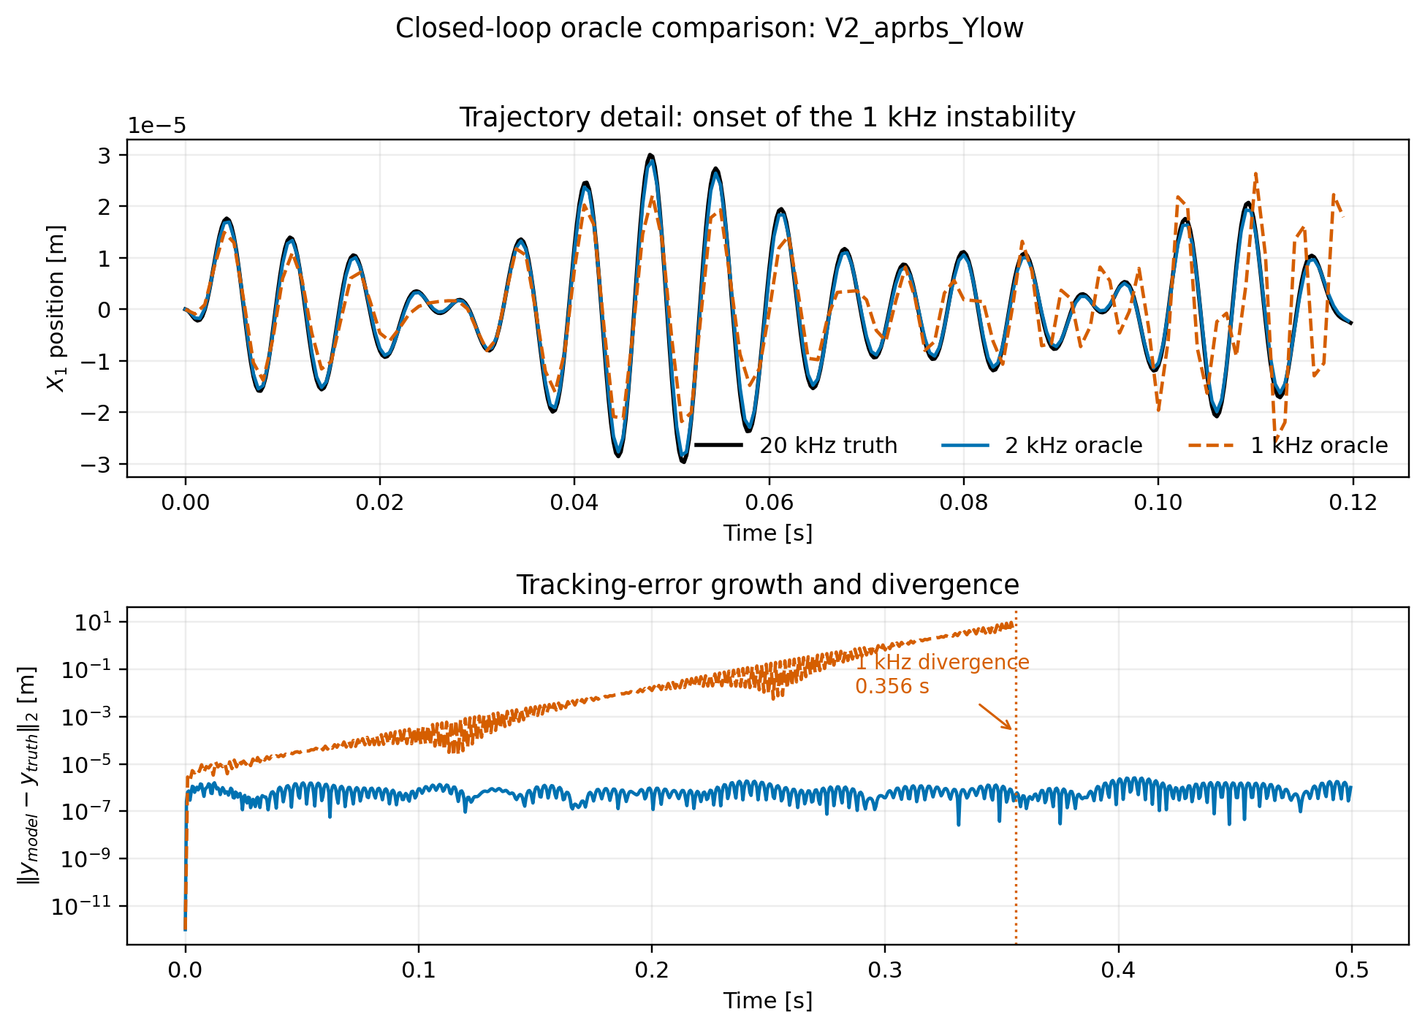

Slide 52
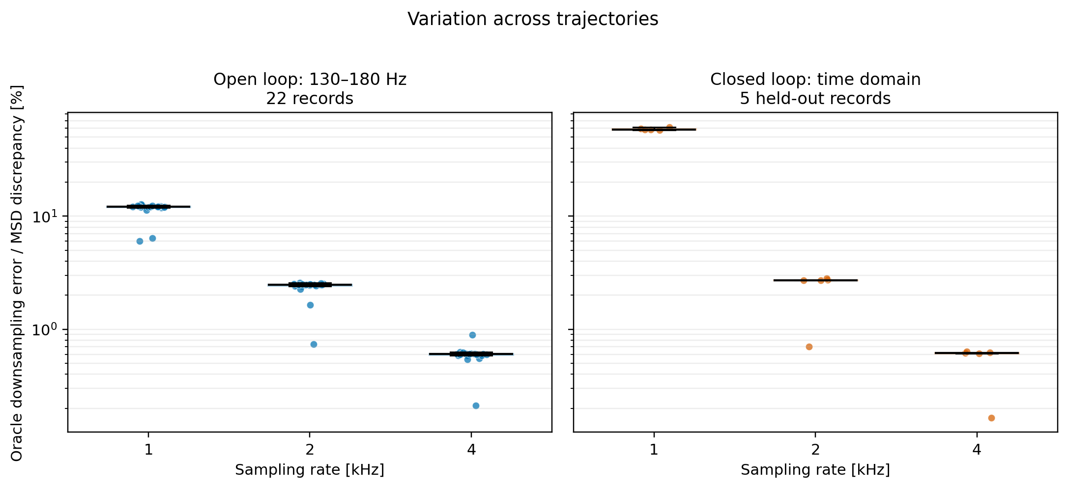

Slide 55
Augmentation
Identified linear dynamics
Not a clean implementation
  But might give insight in how to fix the current training issues
  Similar to full-black box approach with initialization
Current mismatch between system and model is linear
  Not sure how much this implementation takes away from learning nonlinearities
  Could add cubic spring to the system to verify this part
Note:
  This was done on the 10% - 90% Mass split

Slide 56
Identify poles of the residual
System - Baseline model
Training record
measured u(k), y(k)
│
▼
Baseline closed-loop replay
│
▼
Residual
r(k) = y(k) − yb(k)
│
▼
Fit linear residual model
and extract its complex poles
│
▼
Identified pole used for A_aa
Notes:
Shared-denominator multivariable ARX model from \(u(k)\) to \(r(k)\).

Slide 57
Identify poles of the residual
System - Baseline model
Property | Actual system pole | Identified pole | Difference | Relative difference
Damped frequency [Hz] | 1.581139e+2 | 1.578937e+2 | -2.202000e-1 | -1.392671e-3
Damping ratio [-] | 5.000000e-2 | 5.275827e-2 | +2.758270e-3 | +5.516540e-2
Notes:
Shared-denominator multivariable ARX model from \(u(k)\) to \(r(k)\).

Slide 58
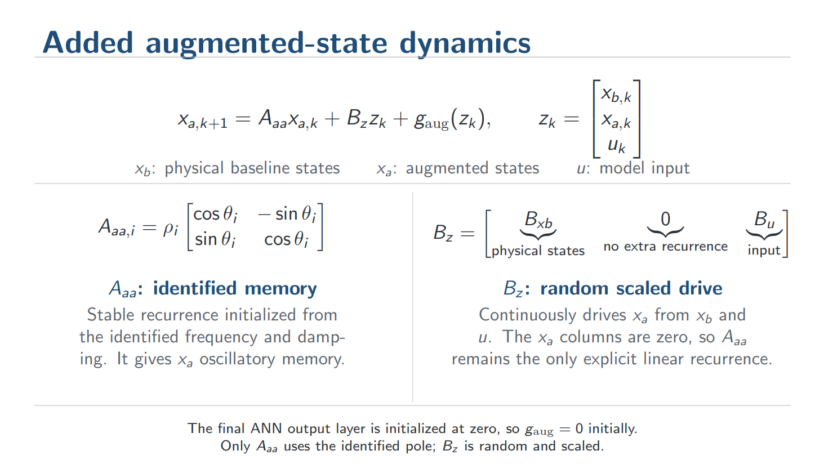
Notes:
Random (draw_input_map, line 349): entries drawn i.i.d. U(-1, 1) from a dedicated torch.Generator seed (so the draw is reproducible and does not disturb the global RNG stream / batch order). The x_a columns are then hard-zeroed as a structural invariant, so A_aa stays the only explicit linear recurrence.
$B_z$ is an $n_a \times n_z$ matrix that maps $z_k = [x_{b,k};,x_{a,k};,u_k]$ into one scalar drive per augmented state, $d_k = B_z z_k$, with the $x_a$ columns held at zero so it only mixes physical states and input. That drive enters the update $x_{a,k+1} = A_{aa}x_{a,k} + d_k + g_{\mathrm{aug}}(z_k)$, so $B_z$ sets which combination of measured signals excites each oscillator and $A_{aa}$ sets the frequency and damping with which that excitation is retained.
$B_z$ is a mixing matrix: each of its rows takes a weighted combination of the physical states and the input, producing one drive signal per augmented state. At every sample that drive strikes the oscillators defined by $A_{aa}$, so $B_z$ decides what the augmented states listen to while $A_{aa}$ decides what they remember.
You have a vector $z_k$ that stacks everything the block can see at time $k$: the physical baseline states, the current augmented states, and the input.
That single scalar is what gets pushed into state 3 at that time step. $B_z$ answers one question, and only one: which weighted combination of the physical states and input does each augmented state listen to?
The one-line version: $A_{aa}$ decides what the extra states remember; $B_z$ decides what they are listening to; the ANN decides what to do with the result. Only the first is identified from data. The second is a generic random guess that training refines.

Slide 59
Augmentation
Overview
Notes:
Kijken gaug is dat augmented states?

Slide 60
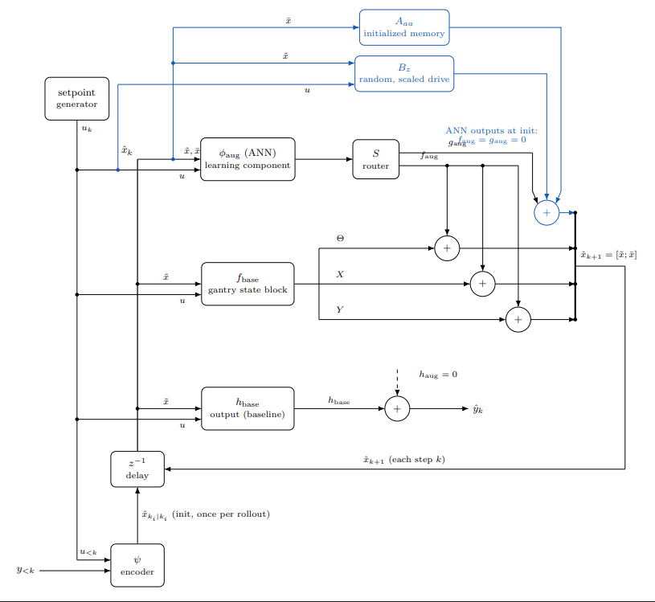

Slide 61
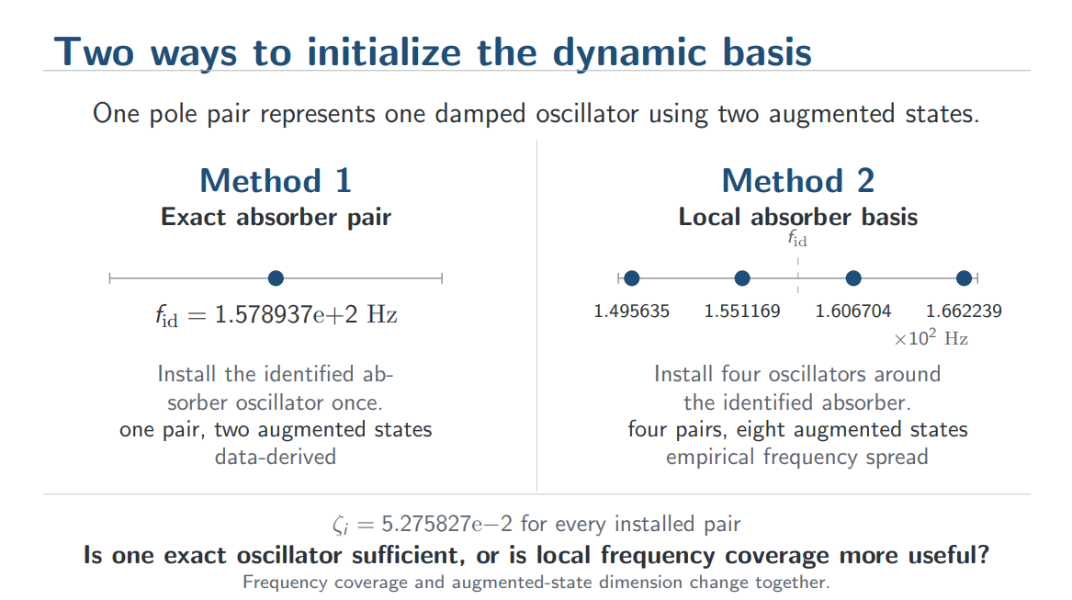

Slide 62
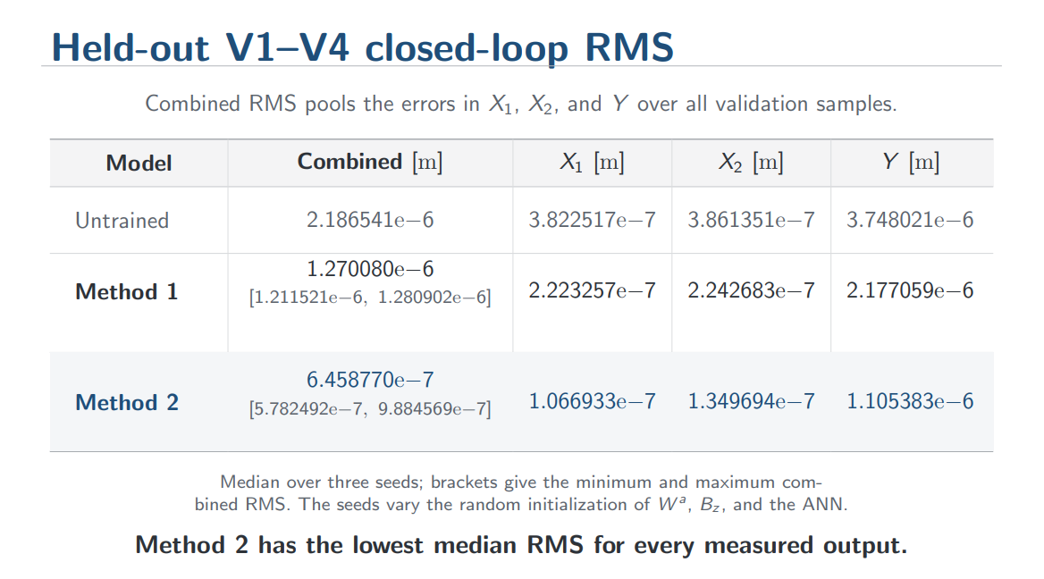
Notes:
Nonlinear capabilities gone?

Slide 63
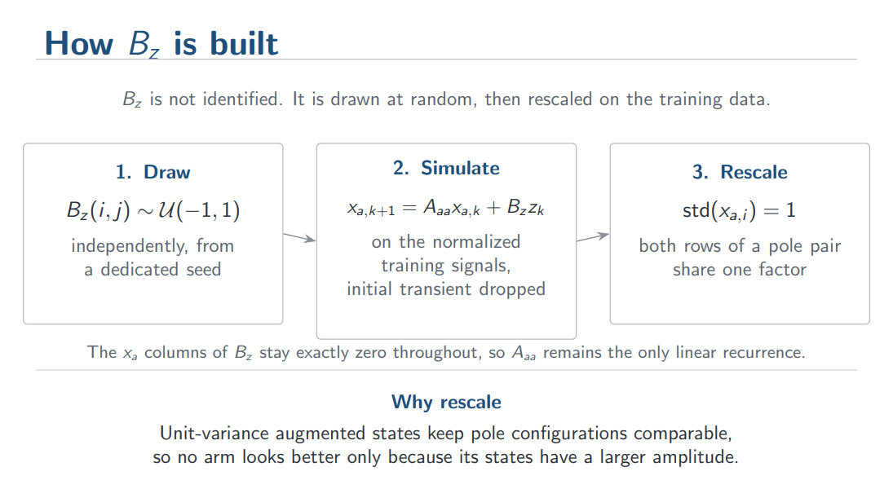

Slide 64
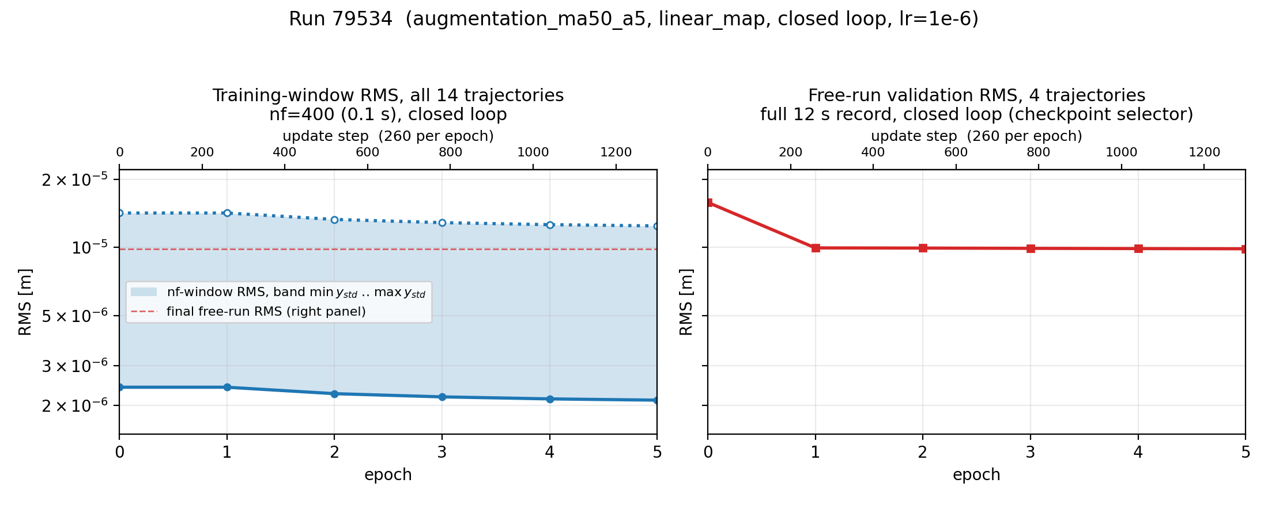

Slide 65
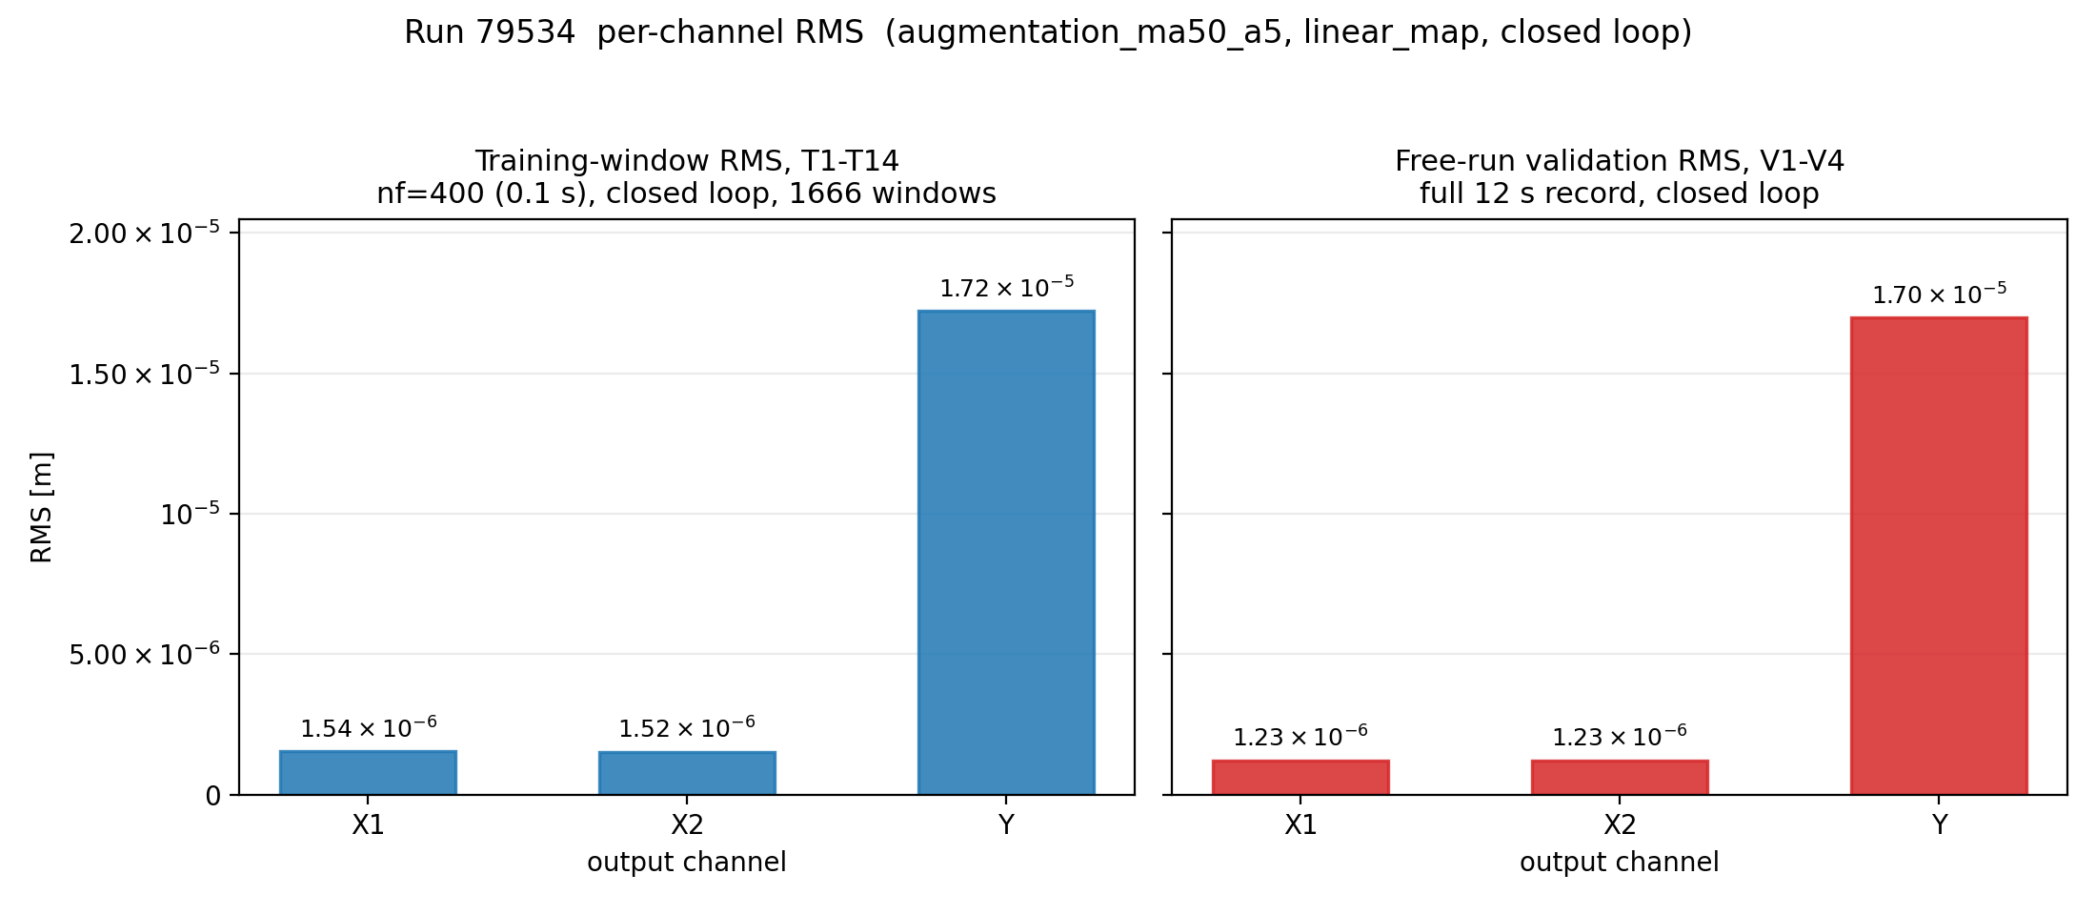

Slide 67
Your X and Y rows carry genuine poles at exactly 1 (the rigid-body double integrators, D-118). So any constant force the ANN injects gets integrated twice and appears as a quadratically growing position offset. Lengthening the window makes the loss see that offset, but it does not remove the mechanism that produces it. You would be using a 2x more expensive objective to apply pressure against something you can constrain directly.This is also the thread the project has already been down: the DC-accumulation work, gantry-zero-mean/v3_dc_birth_monitor.py, dC_boundedintegral_train.py, and the msd-offset mechanism doc all exist because of this failure mode.The decisive diagnostic already exists, and it is one forward passD-168 specifies exactly this: decompose the in-window residual onto span{1}, span{1,t}, and span{1,t,t^2}, per window per channel. The shape of the offset tells you its source, and the two answers point in opposite directions:Residual shape: affine in tSource: encoder initial-state errorDoes a longer horizon help?: No. It is a per-window initerror. Longer windows amortise it over more samples, so itlooks better while nothing improved───────────────Residual shape: quadratic in tSource: constant force injected by the ANNDoes a longer h. The fix is azero-mean or bounded-integral constraint on the injection,not more secondsIf the offset iproduce a lowerreported loss for the wrong reason and you would draw the wrong conclusioorth spending an hour to rule out.
Your X and Y rows carry genuine poles at exactly 1 (the rigid-body double integrators, D-118). So any constant force the ANN injects gets integrated twice and appears as a quadratically growing position offset. Lengthening the window makes the loss see that offset, but it does not remove the mechanism that produces it. You would be using a 2x more expensive objective to apply pressure against something you can constrain directly.

Slide 68
Ook benoemen offset error, maar er komt nog steeds een offset en nog nooit geleerd in open loop alleen closed-loop maar mis omdat closed-loop problem surprised?

Slide 69
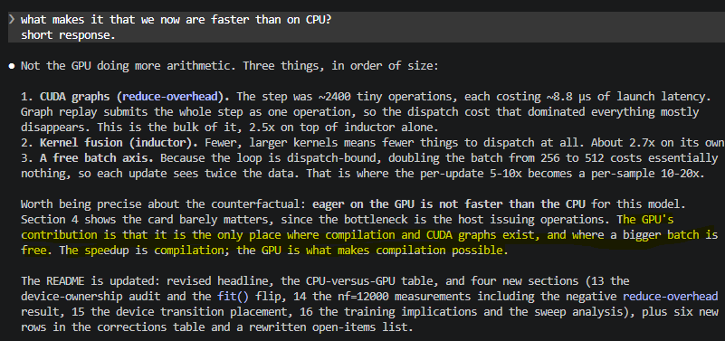
GPU speedup
The one-sentence version for your supervisors: the speedup is not from the GPU computing faster, it is from compilation removing per-operation dispatch overhead in a loop that was overhead-bound, plus a batch axis that is free once you are overhead-bound rather than compute-bound. The GPU matters only because CUDA graphs and Triton codegen exist there and not on the CPU.
eager mode every one of those 2404 operations is dispatched separately
  So eager GPU cannot beat the CPU here, and your null result was the correct measurement of the correct thing. Your supervisors' claim about the type of calculation is also correct as stated: the arithmetic genuinely does not benefit.
The one-sentence version for your supervisors: the speedup is not from the GPU computing faster, it is from compilation removing per-operation dispatch overhead in a loop that was overhead-bound, plus a batch axis that is free once you are overhead-bound rather than compute-bound. The GPU matters only because CUDA graphs and Triton codegen exist there and not on the CPU.

Slide 70
1. The rate floor. At 4 kHz co-rate the exact-model floor is 8.4e-08 m. 1e-07 is 1.2x above it, so you are asking training to reach the discretisation limit of the sampling rate. That is not an optimisation problem you can solve with epochs.

Slide 71
Cant learn open-loop. Closed-loop suppresses?
Closed-loop training degrades open-loop performance
Same for kessels paper
ASMPT is fine with closed-loop

Slide 72
Grotere error complexere error misschien cubic spring?

Slide 73
Kijken open-loop grotere window?

Slide 74
Hoe nuttig is deze paper?
On the normalization of gray-box state-space neural networks
https://www-sciencedirect-com.dianus.libr.tue.nl/science/article/pii/S0005109825005552

Slide 75
Orthogonality papers
Exact title, and it differs by version:- Published: "Regularised orthogonal machine learning for nonlinear semiparametric models", Econometrics J. 25(2):233-255, 2022- arXiv: "Regularized Orthogonal Machine Learning for Nonlinear Semiparametric Models"

Slide 76
Earlier issue additional states not learning

Slide 77
how does jan hoekstra in his paper check that the augmentation for the additional states worked? can you check this for me.
4. The closest thing to your question, and it is a magnitude comparison, not a correctness one (Figs. 6, 8). He plots the baseline states x̂ against the learning component's output φ_aug for every state. On the baseline states x1..x4 the learned contribution is small; on the added states x5, x6 the signal is entirely the learning component. His conclusion: "the learning components are augmenting the baseline model ... and not replacing the baseline model with their own dynamics. Therefore, we have obtained an accurate model whose dominant behavior is given by an interpretable baseline model."

